Slide 1
Node.JS and Express.JS

Slide 2
What is Node.js?
Node.js is an open source framework/ runtime environment that utilizes Javascript.
It is primarily used for back-end applications, such as servers.
Primary benefit of this is to utilize one language for most aspects of web-development, which can speed up web development.
Also, easily scalable.
Notes:
https://nodejs.org/en/about/

Slide 3
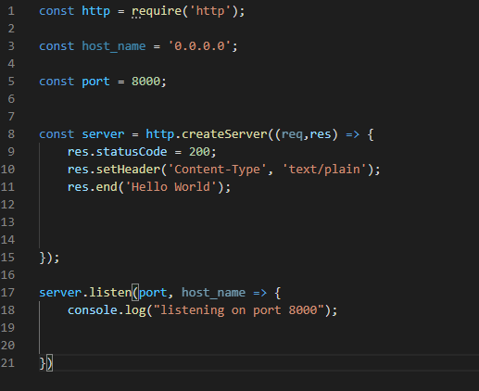
Simple Node.js server
Creating a server within in Node.js ends up being somewhat low level in terms of what you have to do, in order to get a server set up.
In this case you import the http class.
Dictate a host name (usually ip address), and port number.
Then instantiate a variable that correlates to the http class method createServer.
Within this, we set the status code to 200 (Ok or the response/request is accepted).
Set the header stating that what is going to be sent is text
Then at the end of the body of the response being sent, we finish with “Hello world”.
Notes:
Talk about what they see (it requires the HTTP class),
It then Needs a the hostname or ip address
The server is created from the http class, createServer method. Which will then have a request and a response.
A response is what is sent to the users and a request is what a user sends to the server.
The .listening initializes the server.

Slide 4
Express.js
A web application framework built upon Node.js.
Contains utility methods and middleware that help with managing a myriad of use cases such as dealing with HTTPS verbs( GET, POST, DELETE, ect).
Allows for quick creation of servers, without the need of reinventing the wheel (mozilla)
Notes:
Explain response methods)
https://developer.mozilla.org/en-US/docs/Learn/Server-side/Express_Nodejs/Introduction

Slide 5
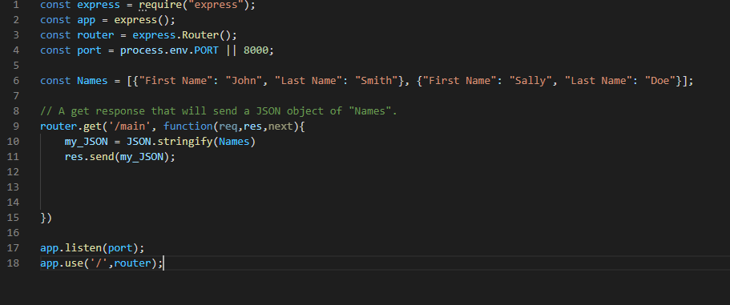
Express.JS example
A basic Express server:
Converts the array of name objects to a JSON then responds to the client when the url changes to “/main”.
In this case: “localhost:8000/main”
This is much quicker and simpler than utilizing basic Node.js!
Notes:
This is sending JSON data to the user.

Slide 6
Installation (windows).
To first get started, you will need to install node.js, this can either be done through an installer or package manager. (installation link: https://nodejs.org/en/download/) . Downloading the node.js installer will give you access to npm ( a package manager) via the command prompt.
To install express.js, open the command prompt. Then use the command mkdir appName, then change to that directory with cd appName.
Then type npm init to initialize a package.json (within this you will want type the file name for the entry point, such as index.js).
Next to install express type this command npm install express --save. Then, there you go.
Then you can use whatever code editor you want to code in!

Slide 7
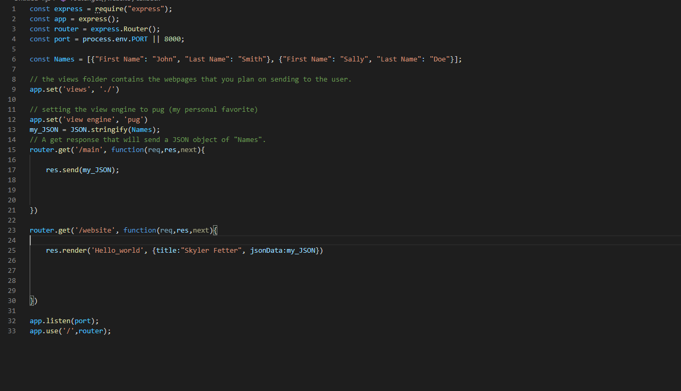
Displaying a website
Sending the code for a website requires a few extra steps and some personal preference choices.
Express will need a rendering engine in order display the html code.
Rendering engine examples: Pug, Mustache, and EJS (Embedded JavaScript templates). For Express, the default engine is Pug.
Notes:
https://expressjs.com/en/guide/using-template-engines.html

Slide 8
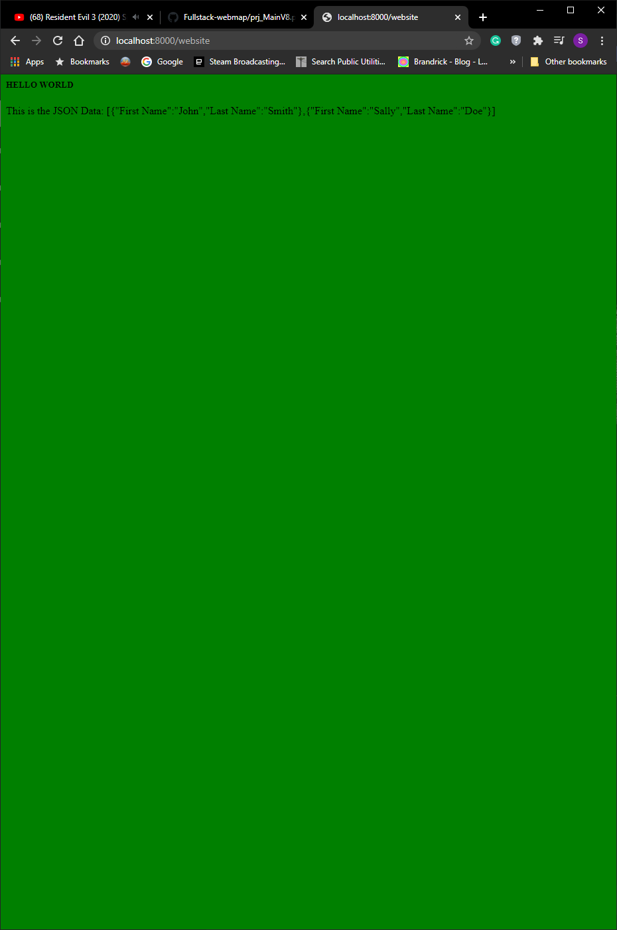
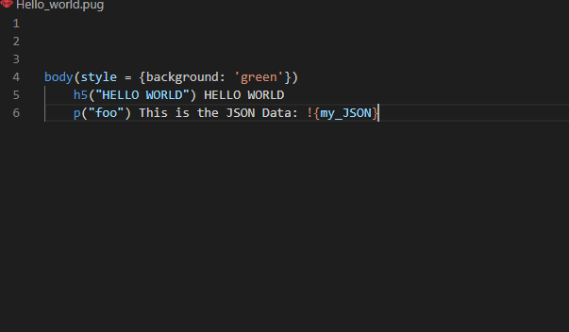
Website

Slide 9
Displaying spatial data with Express.js
There are several ways that this can be done, some options can be through already having the geoJSON data as a file or through querying a database (either through internal means or external means, such as when you connect to CartoDB in your front end code).
Whatever way you decide to to do it is up to you. All you need to do is to send the data to the client when appropriate.
Compatible databases for Node.js and Express.js: https://expressjs.com/en/guide/database-integration.html (Another PostgreSQL option: node-postgres)
Notes:
The difference between pg-promise and node-postgres https://stackoverflow.com/questions/40213386/node-postgres-vs-pg-promise-for-nodejs-application#:~:text=1%20Answer&text=pg%2Dpromise%20uses%20node%2Dpostgres,you%20feel%20more%20comfortable%20with.
Pretty much pg-promise is higher level than node-postgres and utilizes promises.

Slide 10
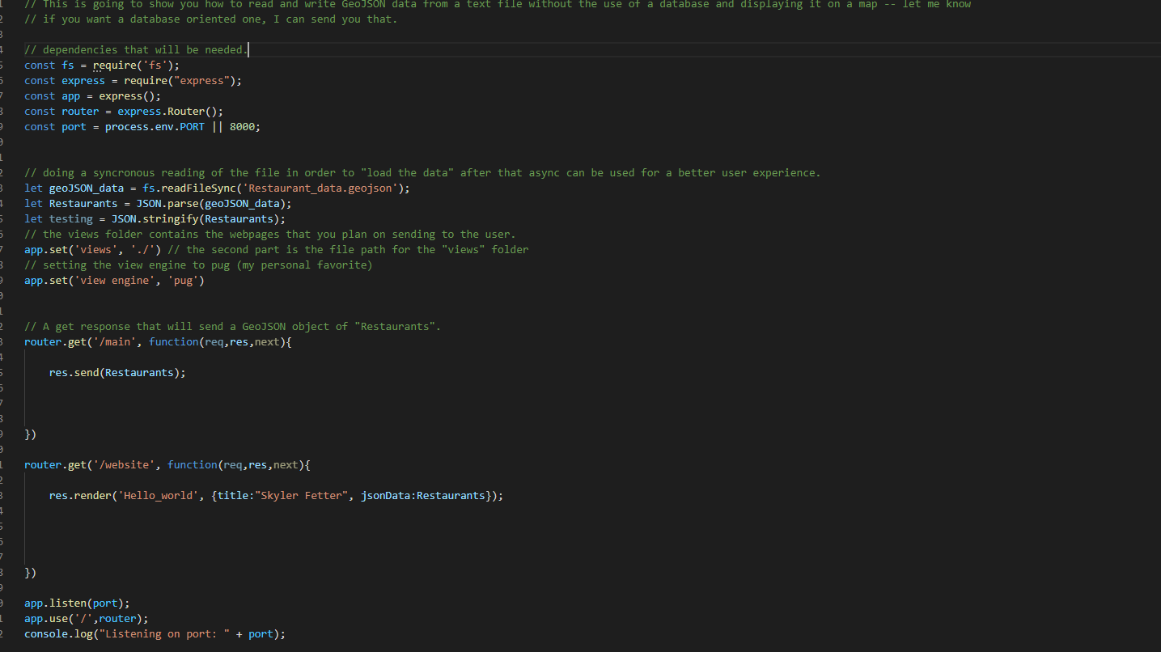
Server Example with no database
This is a basic example of sending a GEOJSON file to a web map.
There are many parts that go into this

Slide 11
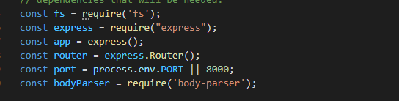
The initial steps
This initial part is for setting up the server itself
Require, is used to tell what modules will be needed for this program, much like import.
app , sudo names express
Router sudo names the router class from express
Fs allows for the program to read files (since this will not be hooked up to a database).
Port dictates which port you will use to send and receive data, in this case 8000
bodyParser will allow you to interact with the body of a response.
Notes:
More info on port selection: https://stackoverflow.com/questions/10476987/best-tcp-port-number-range-for-internal-applications

Slide 12
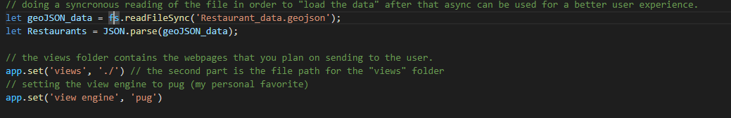
Getting the GeoJSON data
readFileSync(json filepath) will read the GeoJSON and then return it to a variable. In this case geoJSON_data
Once read, the GeoJSON data will need to be parsed and turned into an actual object, in this case Restaurants
app.set(‘views’, ‘./’) dictates where the views folder is located, which will contain the website files.
The last line of code dictates which view engine is going to be used, in this case Pug.

Slide 13
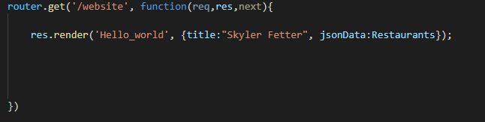
Sending the website
Sending a website requires a GET method from the router.
Within the arguments, it requires the URL address, and then a function that contains either request (req), a response (res), or next).
Within this, a response will render the website (Hello_world), along with sending the GeoJSON/JSON data and a title)
So, when accessing this you would go to localhost:8000/website.

Slide 14
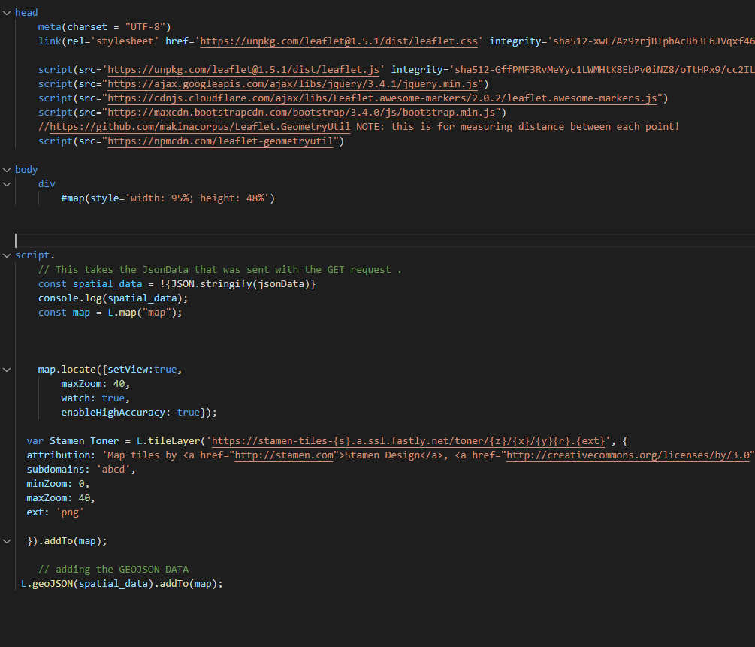
The website file (if using Pug)
Pug, or Jade, as it used to be called, is a template engine for developing html code.
Its main purpose is to make html code easier to read and write.

Slide 15
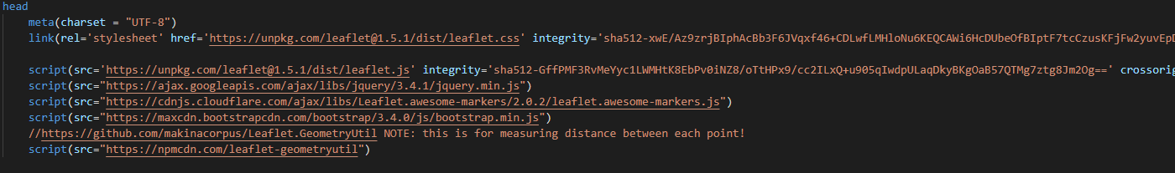
Head
The Head will contain all the scripts and style sheets that need for your website.

Slide 16
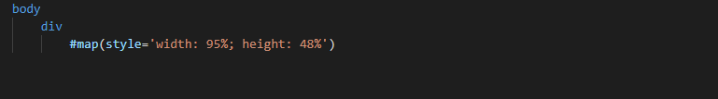
The body of the html
The body of the html will contain whatever the the programmer wants the user to see.
In Pug you do not have to utilize <bod></body> as it is all based on indentiation (much like python).
A div is just a container element that will contain certain parts of a website. These are often used to allow for easy organization of a website.
Lastly within the div, is the map.

Slide 17
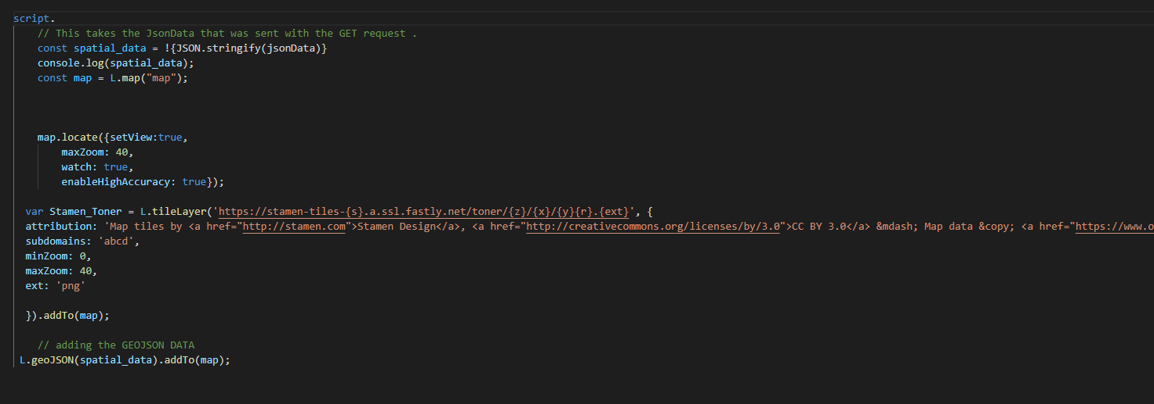
Visualizing the data
The !{JSON.stringify(jsonData)} takes the json data that has been sent from the express server and turns it into a string.
This is then stored as spatial_data.
After a leaflet map is created, and a map style is chosen, just add the data to the map with L.geoJSON (you can expand on this and use layer features).

Slide 18
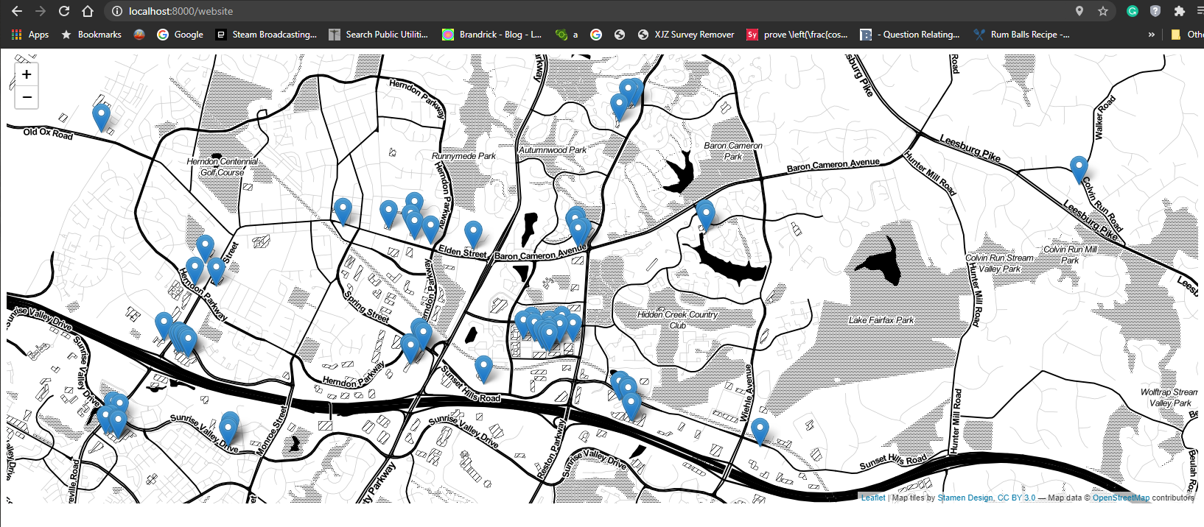
The Output!
In order to see if everything works: type in the command prompt: node (name of the server file) and it will run….or not and tell you why.
If it works, you should see something like this!

Slide 19
What about adding new data?
Adding new data to the GeoJSON requires a few extra steps than getting the data.
Some assumptions: let us assume we plan on adding the new data server side, instead of adding it to the front end. Let us also assume that we will just save the new data to the GeoJSON.
In order to submit or add new data to our GeoJSON file, we will need to add some new code to the front-end, as well as the back-end; in order to create a seamless experience.
Ideally though, you SHOULD use a database instead.
Notes:
Note: if wanting to actually use a database, you will require several extra steps. Ideally that should be the way to go in terms of accessing and storing data, but for now.

Slide 20
What about adding new data? cont
To do this, we will need to utilize AJAXs or Asynchronous JavaScript And XML. This allows for communication to the server from the web client.
As well as Jquery, which is javascript library that helps with AJAX calls and DOM manipulation. (https://www.w3schools.com/jquery/jquery_intro.asp)
Adding it to your website is as easy as adding the script for it : https://ajax.googleapis.com/ajax/libs/jquery/3.4.1/jquery.min.js
Side note : Alternative to JQuery http://youmightnotneedjquery.com/ it utilizing the base XMLHttpRequest. It has been argued that you do not need to rely on JQuery anymore
Notes:
Alternative to JQuery http://youmightnotneedjquery.com/ it utilizing the base XMLHttpRequest. It has been argued that you do not need to rely on JQuery anymore

Slide 21
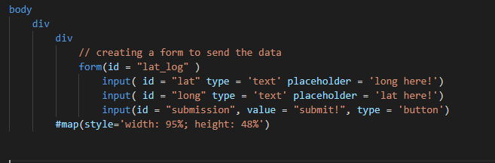
Setting it up: Client-side
WIthin the body we will create another div to house a form.
Within this form we will add three inputs: 2 text boxes, and a submit button.
For two of the inputs, we will state that they will be text, and the last one will be a button.
The id can be whatever you want it to be. But make it reasonable.

Slide 22
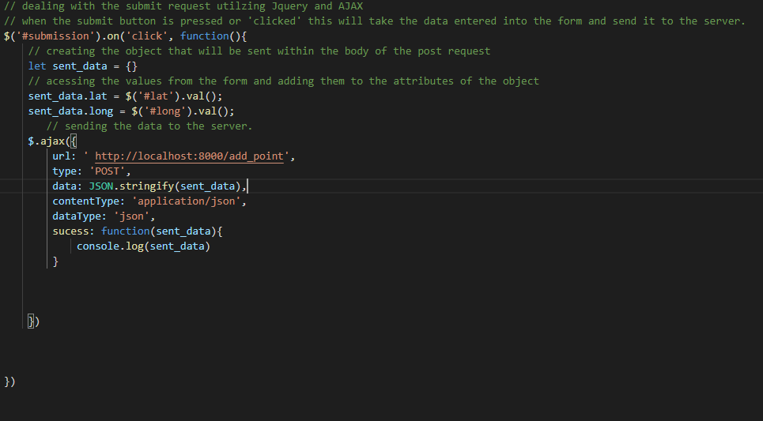
Setting it up: Client-side
In the script section of the code, we will add some JQuery.
The first line dictates that when the element with the id, submission, is clicked, it will do the following:
An object is instantiated called sent_data, which will then add the value from the lat id and long id to the object’s lat and long attributes.
Within the AJAX call, we must dictate what url we will send it to.
The type of request, in this case, POST.
Then a string representation of the object.
Then the data type will be sent as a JSON data type

Slide 23
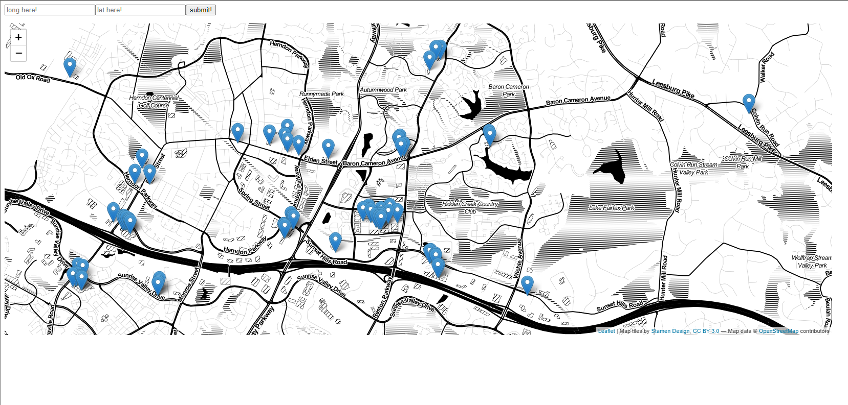
The new web map

Slide 24
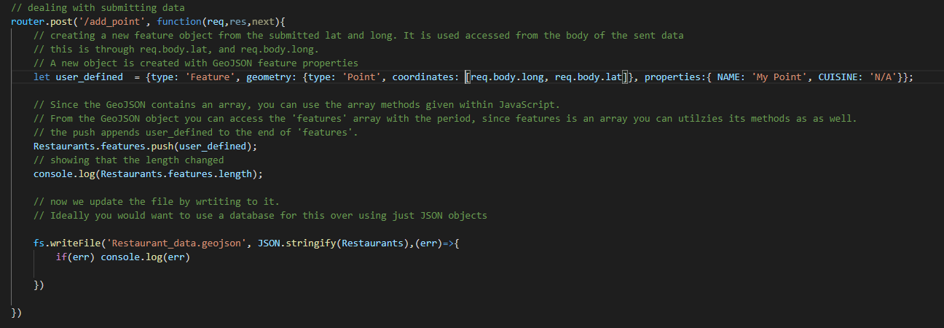
Setting it up: Server-side
For the server side, we tell the router to expect a POST at localhost:8000/add_point.
The object user_defined is created with the same format as a feature would in a GeoJSON. However, for the coordinates, we utilize req.body.lat, and req.body.long. This will take the lat and long from the body of the request and put them within their respective locations.
We then append the new feature to the features portion of the GeoJSON with push (an array method).
The last step is to write it back to the file it came from.

Slide 25
What is next?
In a developmental situation you can use ngrok as a means to test out your website/server.
If you want to deploy, you do have the option to use Amazon Web Services.
https://2c0c4401c137.ngrok.io/main
https://2c0c4401c137.ngrok.io/website
https://2c0c4401c137.ngrok.io/database

Slide 26
What about using an actual database?
Since it is best practice to utilize a database for when dealing with the backend of a web application, it would also be a good idea to go through a simple installation and utilization of one with respects to Express.js
For this example, we will be using PostgreSQL along side PostGIS, and using node-postgres as the middleware to interact between the server and the database. However, you can use whatever you feel like using That is the beauty of programming!
A word of warning: node-postgres is characterized as being somewhat low-level a more easier one to use is pg-promise.
However, node-postgres will, in my opinion will give you better control and understanding of manipulating spatial data between formats, and sql.

Slide 27
Installing Postgresql and PostGIS (windows)
PostgreSQL Download link for all OSes: https://www.postgresql.org/download/.
Click on your preferred operating system. If working on windows, click the windows icon which will bring you to a new screen.
There will be a clickable link called Download the installer, click it, and click your appropriate os and the latest version, if you can.
When installing the .exe, feel free to keep all the components.

Slide 28
Installing Postgresql and PostGIS (windows) cont
When prompted to create a password, put whatever you would like, but be sure to keep track of it. You will need this!
Next type a port you would like to use, just dont use the one used for the Node.js/express.js server! (keeping it the default 5432 works for this).
Then click the locale that will be used (English, United States).
After installation, you will be asked if you want to install EDB Stackbuilder, allow this to happen; it will make installing PostGIS much easier.

Slide 29
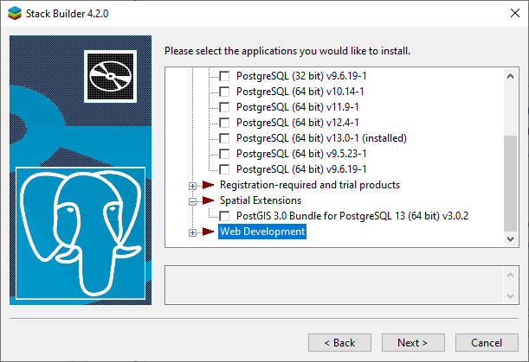
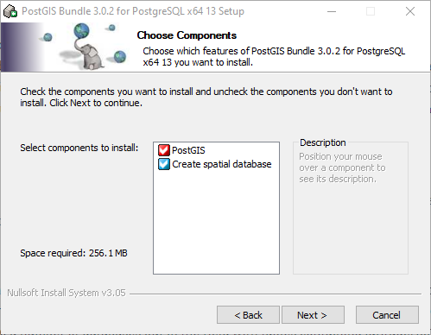
Installing PostGIS
Within the Stack Builder, scroll down till you see Spatial Extensions, click this, and you can then install PostGIS.
As things are installing you will then have the option to create a spatial database, check it off.

Slide 30
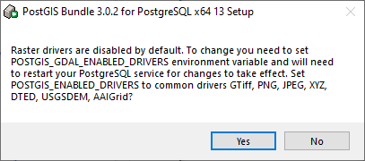
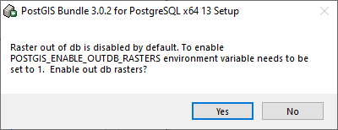
Installation Cont
You will then be asked for the database connection information, this is where you put your password that you created.
During installation you will be asked if you want to register the GDAL_DATA environment, which will allow you play around with raster data, if you would like to use it.
After this you should be good to go!

Slide 31
Utilizing PostgreSQL and PostGIS
There are two ways to interact with a PostgreSQL database:
A more beginner friendly way is through the application called pgAdmin, which comes along with an installation of PostgreSQL.
Or a headless processes via the command prompt (for windows).
Depending on you comfortability and requirements, either one works. BUT you will need to do more setup via a headless processes.

Slide 32
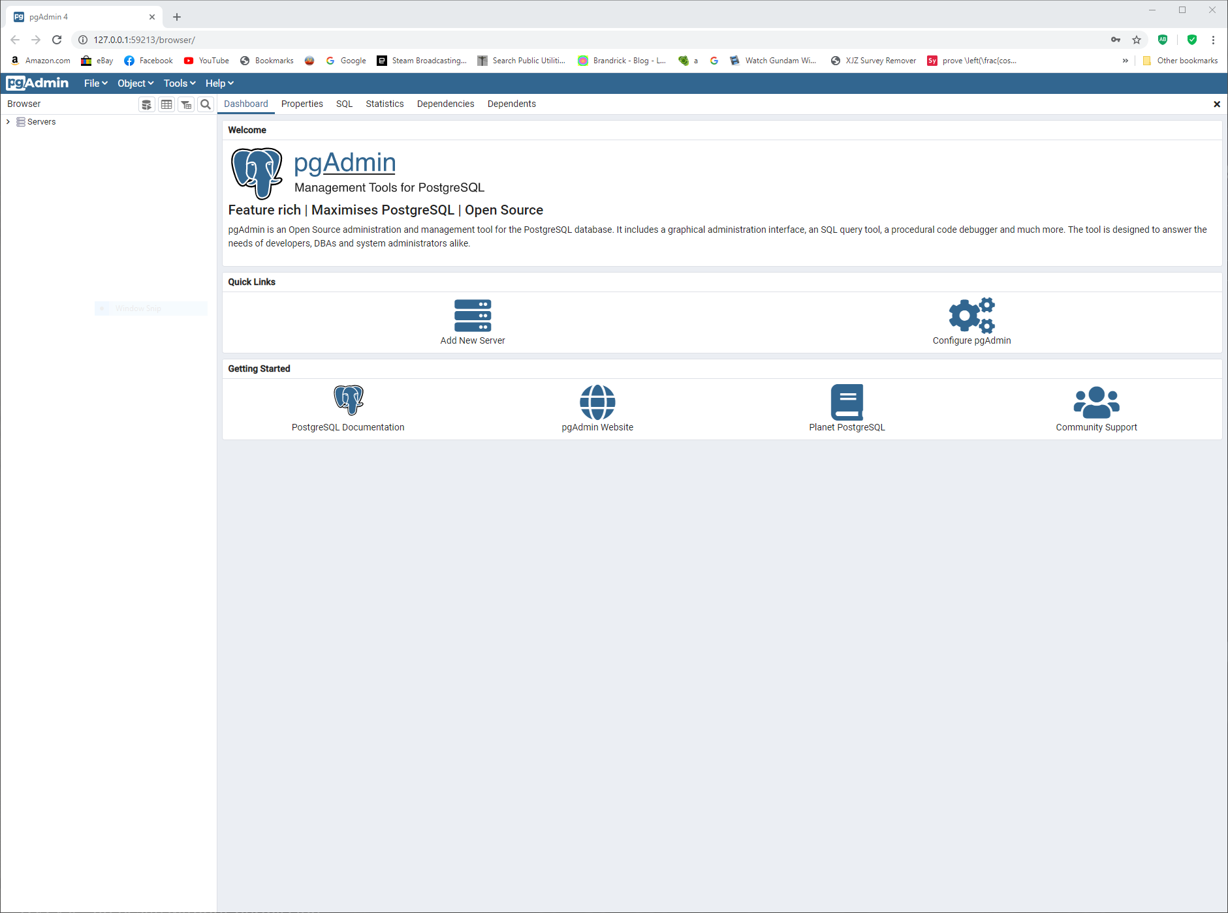
pgAdmin
When opening up pgAdmin, you will be required to put in the password you created during the setup process.
Afterwords, you will be greeted to this screen.
Click on the Server drop down on the top left, you will then need to put in your password again!

Slide 33
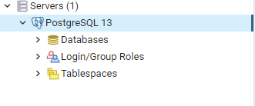
The drop down will contain several trees that you can further look into.
For us, all we care about is the database tree.
Right click it, and you will be given the option to create a database, do so.

Slide 34
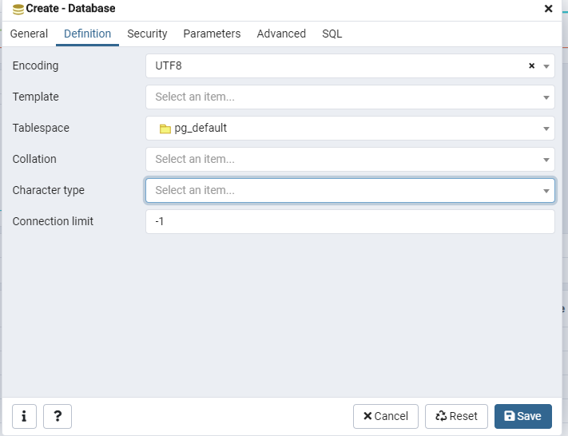
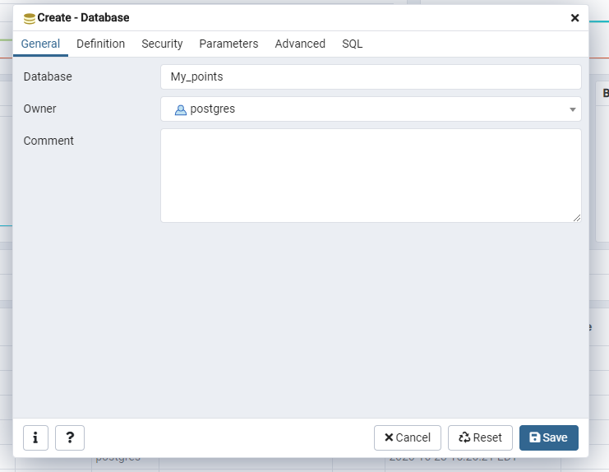
Creating a Database
The first step it to give your database a name.
Don't worry about security or parameters, as this beyond the scope of this lecture.

Slide 35
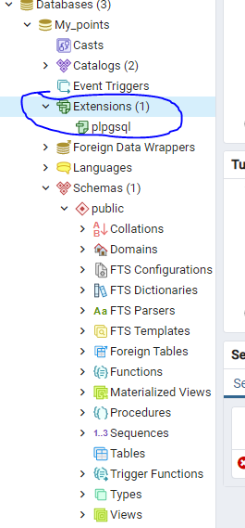
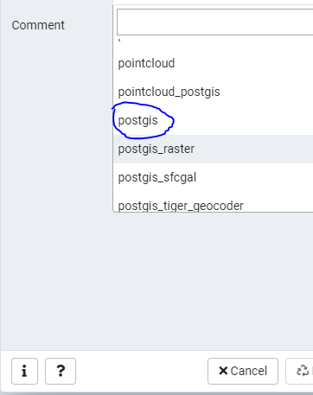
Once the Database has been created!
Once the database has been created, you will want to click on it to drop down a series of other parameters.
To get PostGIS installed on the database itself, right click extensions then click on create.
A new menu will appear with a dropdown button. Click it, then scroll to postgis.
Sleckt it, then click save, you now have postGIS installed on the database!

Slide 36
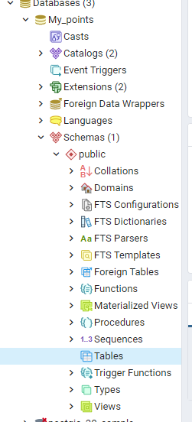
Adding to the database
Select Schemas then select public.
Within this you can right click Tables to create a table.
This table will store your data.
You can have as many tables as you want within a database.

Slide 37
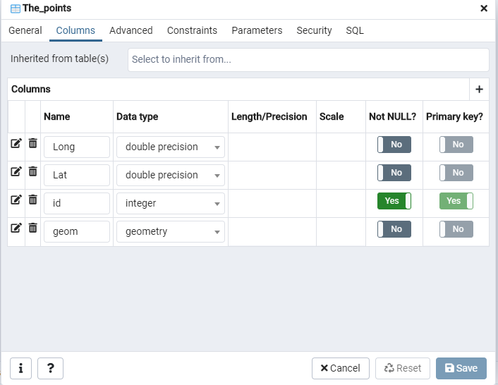
Adding data to a database cont
Right click Tables then select create.
You will then be prompted to add a name for the table. After this, click columns.
Within columns we will add three fields: Long, Lat, and Id, using double precision for lat and long, and integer for id.
Check the primary key?, button for the id.
After the creation of the table, you will now also have a spatial_ref_sys, do not worry about that one.

Slide 38
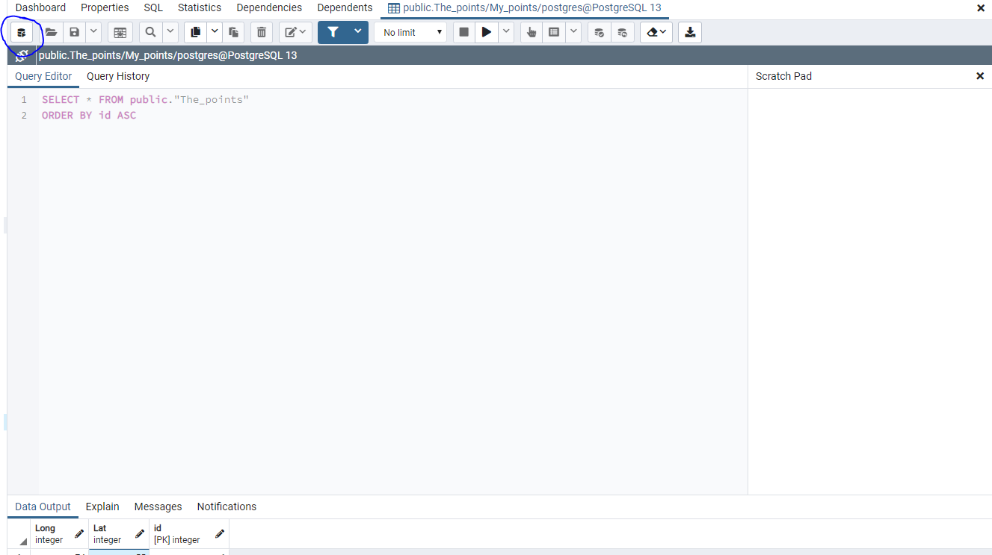
Adding a record
You can either import from a file or add records via SQL statements
To do it through sql, right click the table you made and the click, view/edit data.
Then in the top section of the dashboard there is a query tool, click it.
You will want to insert a new record into the table.
Example:
INSERT INTO "The_points"("Long", "Lat", id)
VALUES (73.556666, 55.44444,1);
Put any other long and lat points in.

Slide 39
Setting spatial context:
Right now, we are just working with data that has no real spatial connection (neither project nor unproject). In order to fix this, we need to create geometry for it.
SQL query: UPDATE the_points SET geom = ST_SetSRID(ST_MakePoint("Long","Lat"),4326).
The ST_SetSRID statement sets the Spatial Reference System Identifiers, which helps define the projection, as well as other important spatial references.
Since we are using points, ST_MakePoint will take the longitude and latitude),
The 4326 is the code number for WG84, since web maps usually take this projection.
Notes:
https://desktop.arcgis.com/en/arcmap/10.3/manage-data/using-sql-with-gdbs/what-is-an-srid.htm#:~:text=A%20spatial%20reference%20identifier%20(SRID,use%20to%20store%20your%20data.

Slide 40

Setting up the express server.
The first thing that needs to be done, is to install the node-postgres , package from npm by typing npm install pg.
After this we can get to work adding connectivity to the database.
Within the same JavaScript file add const pg = require(‘pg’) and const {client,Query} = require(‘pg’)
These two lines of code will import the node-postgres module, along with getting the Client , and Query Class.

Slide 41
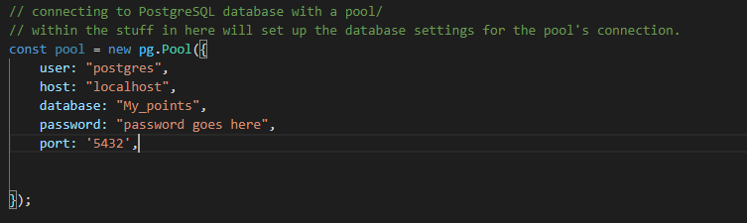
Setting up the express server. Cont:
The first thing that needs to be done is set up the pool class with the parameters that connect to the database.
A Pool contains a number of clients that will connect to the database. (default 10).
This helps reduce slow down as well as reduce wait times for users. (node-postgres)
We are now ready to get the data from the database!
Notes:
https://node-postgres.com/features/pooling

Slide 42
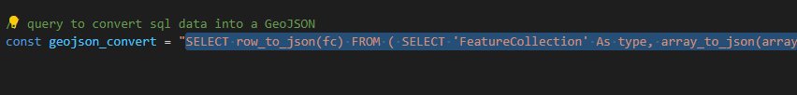
Sending the data to the website:
This will be much like sending the GeoJSON data except with a few extra steps.
First we need to convert sql data into a GeoJSON the following should give you the basic idea on how to do it:
SELECT row_to_json(fc) FROM (SELECT ‘FeatureCollection’ As type, array_to_json(array_agg(f)) As features FROM (SELECT ‘Feature’ As type, ST-AsGeoJSON(lg.geom)::json As geometry, row_to_json((id,’Long’, ‘Lat’)) As properties FROM the the_points lg) As f) As fc
You can store this as a string that can be later used when accessing the website.

Slide 43
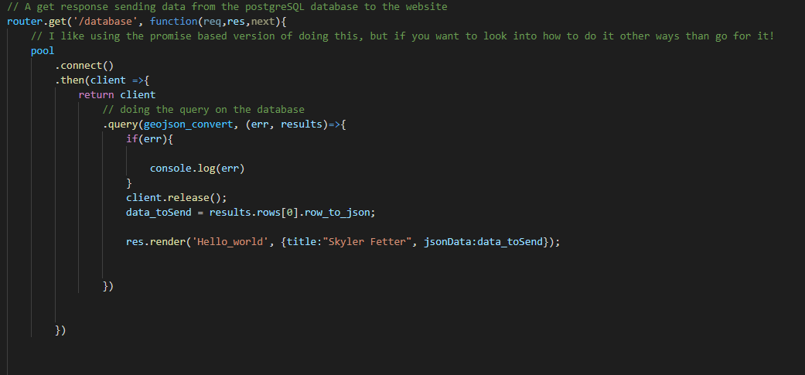
Sending the data to the website
Somewhat similar to the GeoJSON sending GET response.
You connect the POOL to the database, then you take a client and send a the query to the database.
If everything is fine you take the results and
Then send it with response.
And there you go!

Slide 44
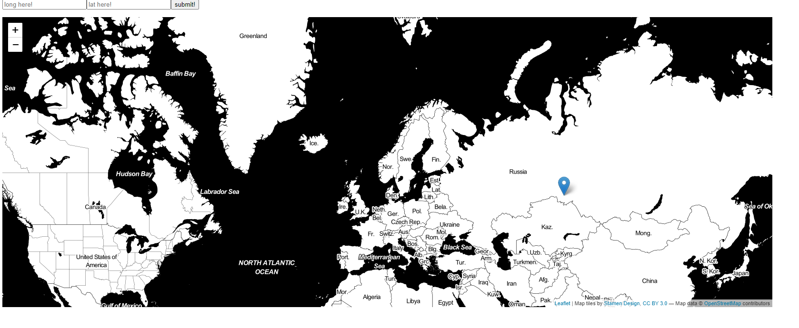
Output

Slide 45
Sources:
(n.d.). Retrieved October 19, 2020, from https://expressjs.com/en/guide/using-template-engines.html
About. (n.d.). Retrieved October 19, 2020, from https://nodejs.org/en/about/
Express/Node introduction. (n.d.). Retrieved October 19, 2020, from https://developer.mozilla.org/en-US/docs/Learn/Server-side/Express_Nodejs/Introduction
Notes:
https://node-postgres.com/features/queries

Slide 46
Sources:
(n.d.). Retrieved October 19, 2020, from https://expressjs.com/en/guide/using-template-engines.html
About. (n.d.). Retrieved October 19, 2020, from https://nodejs.org/en/about/
Express/Node introduction. (n.d.). Retrieved October 19, 2020, from https://developer.mozilla.org/en-US/docs/Learn/Server-side/Express_Nodejs/Introduction
Notes:
https://node-postgres.com/features/queries

